Slide 1
Ch10 Transaction Management
Exercises (Please disregard question numbers – copy/paste error) ☺

Slide 8
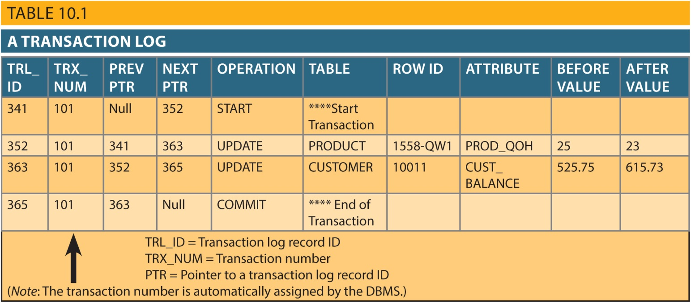

Slide 13
